Slide 1


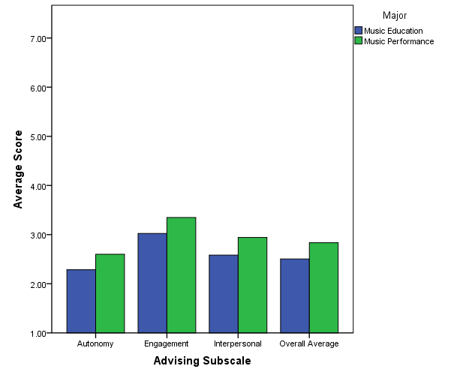
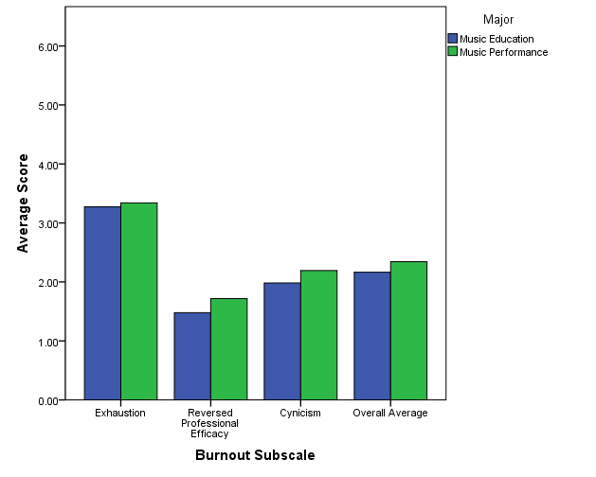
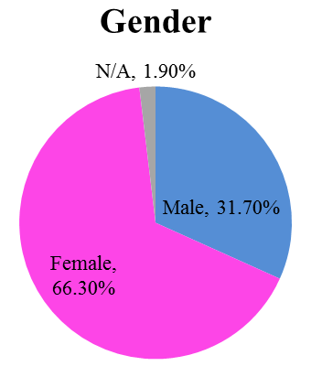
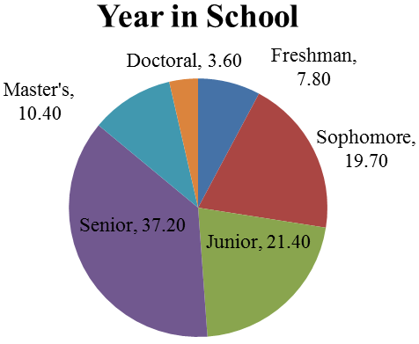
When Music Goes Up In Flames:
The Impact of Advising on the Perceived Burnout of Music Majors
Marilee L. Teasley, Department of Psychology
Abstract
Academic advisors are prepared to engage with a diverse population of students each semester, each bringing their own unique personality and experiences to the advising relationship. Unfortunately, many advisors find themselves meeting with students who display extreme cynicism and exhaustion toward their chosen major, known as burnout. Is there a relationship between perceived academic advisor support and burnout?
To answer this question, over three hundred music majors throughout the country were surveyed. This presentation will discuss the relationships found between advising support (autonomy, engagement, and interpersonal relations), psychological needs (autonomy, relatedness, and competence), and burnout (cynicism, emotional exhaustion, and professional efficacy). Advisors for all academic disciplines are invited to share their experiences!
Correlations
Perceived Burnout & Advisor Support
Music Education majors generally perceived their advisor to be more supportive across all subscales than Music Performance majors, but the difference was not significant.
NOTE: For the Advisor Support Scale, lower advising subscale scores and overall averages indicate higher levels of perceived advisor support.
Academic Advising Autonomy
“If my advisor allows me to make my own decisions, I feel less exhausted, less cynical, and less inadequate.”
Academic Advising: Engagement
“If my advisor helps me get involved, I feel less exhausted, less cynical, and less inadequate.”
Academic Advising: Interpersonal Relationships
“If I am happy with the interactions I have with my advisor, I feel less cynical and less inadequate (no significant relationship with exhaustion exists).”
Hypotheses
Hypothesis #1: Perceived advisor support was expected to negatively correlate with experienced burnout.
Hypothesis #2: Advisor support was expected to predict burnout in music majors, and mediation effects with basic psychological needs were explored.
Hypothesis #3: Music performance and music education majors were expected to experience different rates of burnout and perceived advisor support..
Predictive Relationships
Music Performance majors generally reported higher levels of perceived burnout than Music Education majors, but the difference was not significant.
NOTE: For the MBI, higher burnout subscale scores and overall averages indicate higher levels of perceived burnout.
PSY Needs
Total
Materials
a -.15
b -.85
Introductory Questions:
Demographic Information
Age, Gender, Ethnicity
Student Information
Year in School, Major, Outside Employment
Advising Experience
Advisor Type, Time Spent with Advisor
Music Experience
Instrument, Practice Hours, Ensembles, Professional Organizations
Survey Instruments:
Maslach Burnout Inventory – Student Survey
Advisor Support Scale
Basic Psychological Needs Scale
Advising
Total
c .15
Burnout
Total
c' .03
PSY Needs
Autonomy
a -.14
b -.62
General Discussion
The correlations turned out as expected; students who reported higher satisfaction with advisor support were likely to experience lower levels of burnout.
Using mediation analyses we demonstrated that advisor support predicts experienced burnout, but also that the psychological well-being of students plays an important role in this relationship and should not be overlooked.
Contrary to our expectations, students in different majors did not experience significantly different levels of perceived advisor support or burnout.
Advising
Autonomy
c .14
Burnout
Total
Participants
c' .05
PSY Needs
Relatedness
a -.10
b -.50
Selected References
Burt, T., Buchanan, E.M., Carr, M., Teasley, M. L., Yadon, C., & Young-Jones, A. (2013, May). Academic Advising Assessment: Perceived Support and Scale Development as Outcomes. Poster presentation for the Annual Meeting of the Association for Psychological Science, Washington D.C.
Gagne, M. (2003). The role of autonomy support and autonomy orientation in prosocial behavior engagement. Motivation and Emotion, 27, 199-223.
Hamann, D. L., & Daugherty, E. (1985). Burnout assessment: The college music student.
Update: The Applications of Research in Music Education, 3(2), 3-8.
Maslach, C., & Jackson, S. E. (1981). The measurement of experienced burnout. Journal of Occupational Behavior, 2, 99-113.
Advising
Interpersonal
c .12
Burnout Total
c' .07

